Slide 1
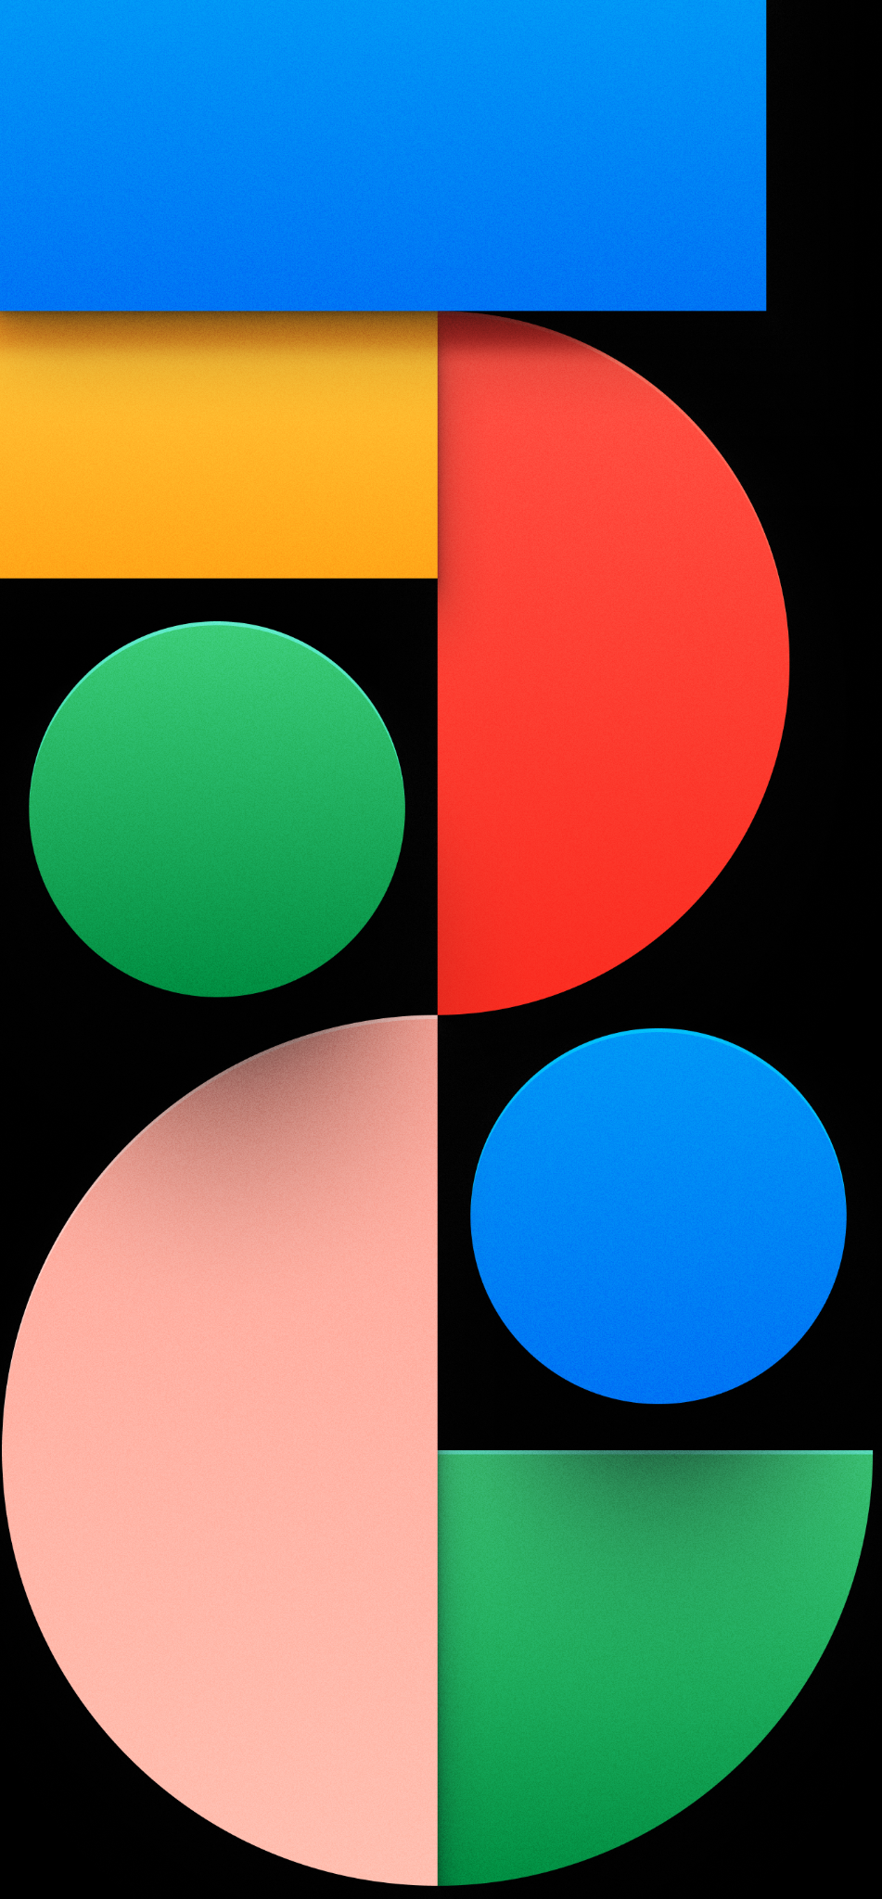
Buttons
Mohamed Elbaiomy

Slide 2
Some Buttons in Flutter
ElevatedButton
TextButton
OutlinedButton
IconButton
MaterialButton
FloatingActionButton
visually prominent button with a filled background that responds to user interactions
a flat button with no background color
an outlined border button without a filled background
a button that consists of an icon.
circular button that floats above the content

Slide 3
Each button widget offers different visual styles and behaviors to suit various user interface requirements. You can customize these buttons by providing child widgets (such as Text or Icon), defining callback functions for onPressed or other interaction events, and adjusting properties like color, shape, and size to match your application's design and functionality.
By utilizing these button widgets effectively, you can create interactive and visually appealing user interfaces that allow users to trigger actions and navigate through your Flutter application.

Slide 4
Two Ways to Customize Style in Buttons
Using ButtonStyle
Using (ButtonName).styleFrom
01
02

Slide 5
Using ButtonStyle
You can customize the button style directly within the style attribute of the ElevatedButton widget. Here's an example:
ElevatedButton(
onPressed: () {},
style: ButtonStyle(
backgroundColor: MaterialStateProperty.all<Color>(Colors.red),
textStyle: MaterialStateProperty.all<TextStyle>(
TextStyle(fontSize: 18, fontWeight: FontWeight.bold),
),
),
child: Text('Submit')),

Slide 6
Using styleFrom
To customize the style of an ElevatedButton in Flutter using ElevatedButton.styleFrom, you can use the styleFrom method to create a ButtonStyle based on a set of predefined parameters. Here's how you can do it:
ElevatedButton(
onPressed: () {},
style: ElevatedButton.styleFrom(
backgroundColor: Colors.red,
textStyle: TextStyle(fontSize: 18, fontWeight: FontWeight.bold),
),
child: Text('Submit')),

Slide 7
GestureDetector
GestureDetector is primarily used for gesture recognition and detection. It detects various user interactions, such as taps, drags, long presses, and more.
It doesn't provide any built-in visual effects or feedback to the user, apart from the underlying gesture recognition.
GestureDetector is a more general-purpose widget that allows you to capture and respond to gestures within a specific area.
It provides callbacks like onTap, onDoubleTap, onLongPress, onVerticalDrag, onHorizontalDrag, and more to handle different types of gestures.

Slide 8
Inkwell
InkWell is primarily used for creating interactive buttons or clickable elements within a user interface. It provides a visual feedback effect called the ink splash effect when the user interacts with the widget, such as tapping it. The ink splash effect creates a circular ripple animation that emanates from the point of interaction, giving the user a visual indication that the interaction has been recognized. InkWell is a specialized widget that combines gesture recognition with visual feedback, specifically designed for creating interactive touchable elements.
It provides callbacks like onTap, onDoubleTap, onLongPress, and more similar to GestureDetector to handle different gestures.

Slide 9
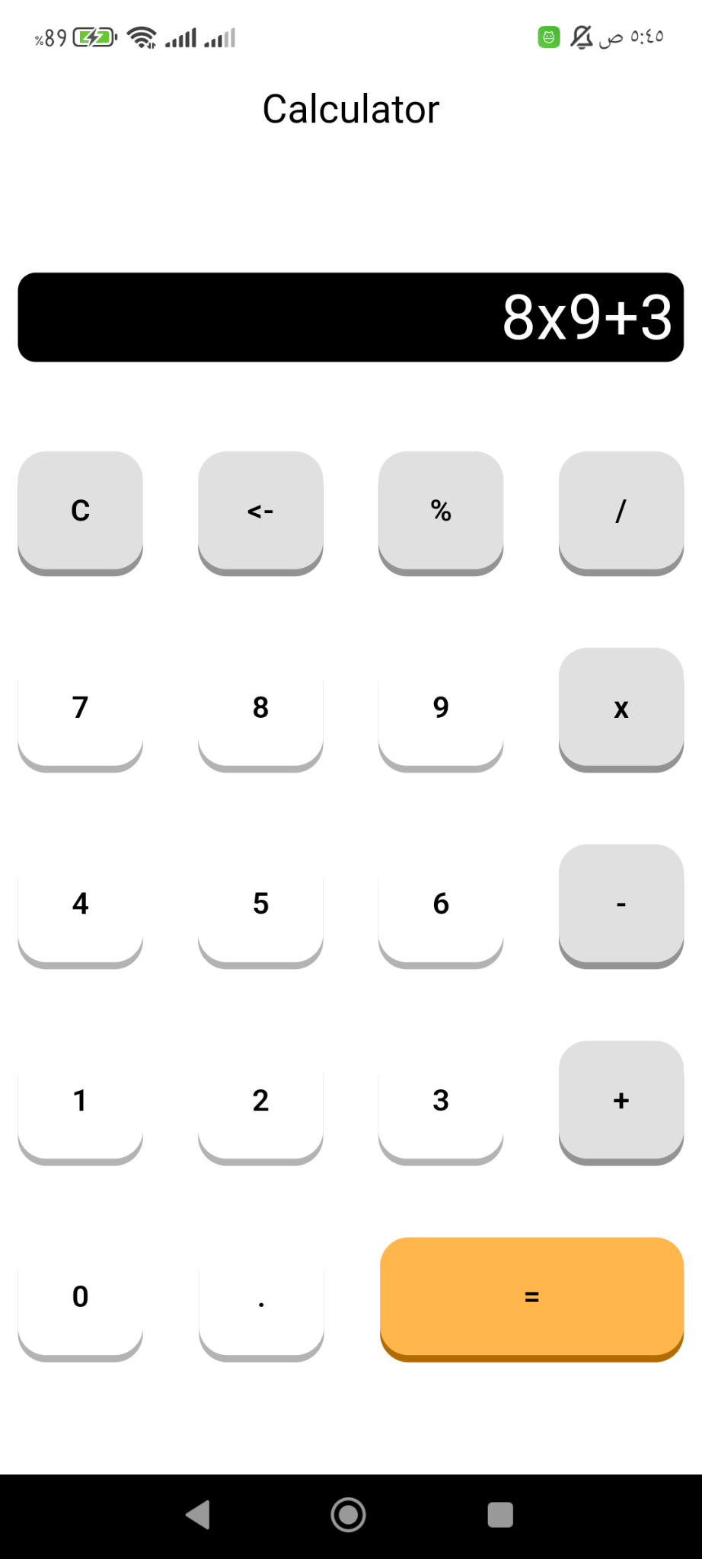
Our Goal
Today

Slide 10
Reusable component in Flutter is a custom widget designed to be used multiple times throughout an application, promoting code reusability and maintainability.
These components can encapsulate specific functionality or UI elements, allowing developers to build complex UIs more efficiently.

Slide 11
Benefits of Reusable Components
Code Reusability: By creating components that can be reused across different parts of the app, developers reduce code duplication, making the codebase cleaner and more manageable.
Improved Maintainability: Changes made to a reusable component automatically propagate to all instances where it is used, simplifying updates and bug fixes.
Enhanced Collaboration: Teams can work on different components independently, improving collaboration and speeding up development.
Consistent UI/UX: Reusable components help maintain a consistent look and feel across the application, enhancing the overall user experience.
Faster Development: With pre-built components, developers can rapidly prototype and build applications, significantly reducing development time.

Slide 12
Math expressions package for ( = ) button
Link

Slide 13
